Slide 1



WCRP
Implementation Plan
World Climate Research Programme (WCRP)
from
Strategy
to
Action
October 2019

Slide 2


WCRP Strategic Plan 2019-2028
Developed 2017-2019 with extensive consultation
Approved June 2019
Our Vision
A world that uses sound, relevant, and timely climate science to ensure a more resilient present and sustainable future for humankind.
Our Mission
The World Climate Research Programme (WCRP) coordinates and facilitates international climate research to develop, share, and apply the climate knowledge that contributes to societal well-being.
www.wcrp-climate.org/wcrp-sp

Slide 3
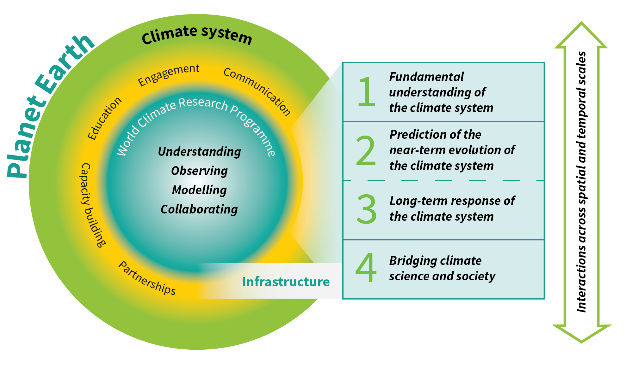
WCRP Strategic Plan: Overview
Scientific Objectives
A hierarchy of simulation tools
Sustained observations and reference data sets
Need for open access
High-end computing and data management
www.wcrp-climate.org/wcrp-sp

Slide 4

Scientific Objectives
We will support and facilitate the advancement of sciences that enable an integrated and fundamental understanding of the climate, its variations and its changes, as part of a coupled physical, biogeochemical, and socio-economic system.
Emphases:
Climate dynamics: past and future global and regional changes in oceanic and atmospheric circulations
Reservoirs and flows: radiative, hydrologic, cryospheric and biogeochemical changes to the reservoirs and flows of energy, water, carbon, and other climate-relevant compounds

Slide 5
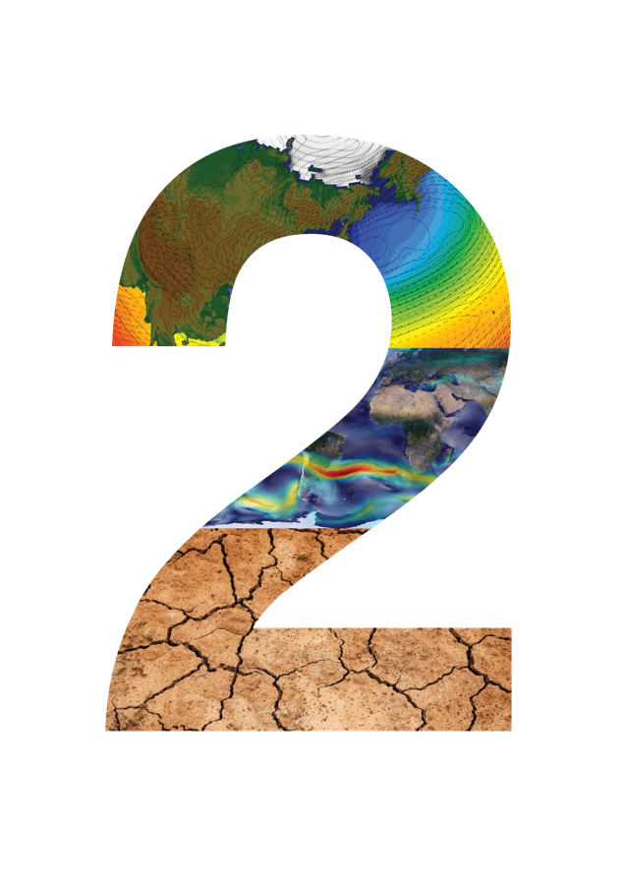
Scientific Objectives
We will push the frontiers of predictions and quantify the associated uncertainties for sub-seasonal to decadal time scales across all climate system components.
Emphases:
Advancing prediction capabilities of component systems and their coupling: Deterministic, statistical and machine learning approaches. Data assimilation, complex networks, and ensemble generation
Predicting extreme events: regional climate hotspots and potential for crossing thresholds. Interactions between fast and slow extremes

Slide 6
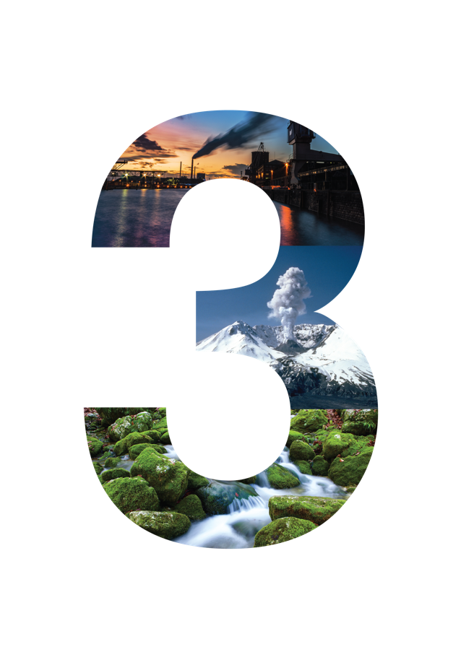
Scientific Objectives
We will quantify the responses, feedbacks, and uncertainties intrinsic to the changing climate system on longer (decadal to centennial) timescales.
Emphasis:
Simulation capabilities: Development of integrated models that account for the slowly varying interactions and highly non-linear processes. Representation of the complex interactions between aquifers, vegetation and soil carbon, permafrost, glaciers, and ice sheets, and human activities

Slide 7
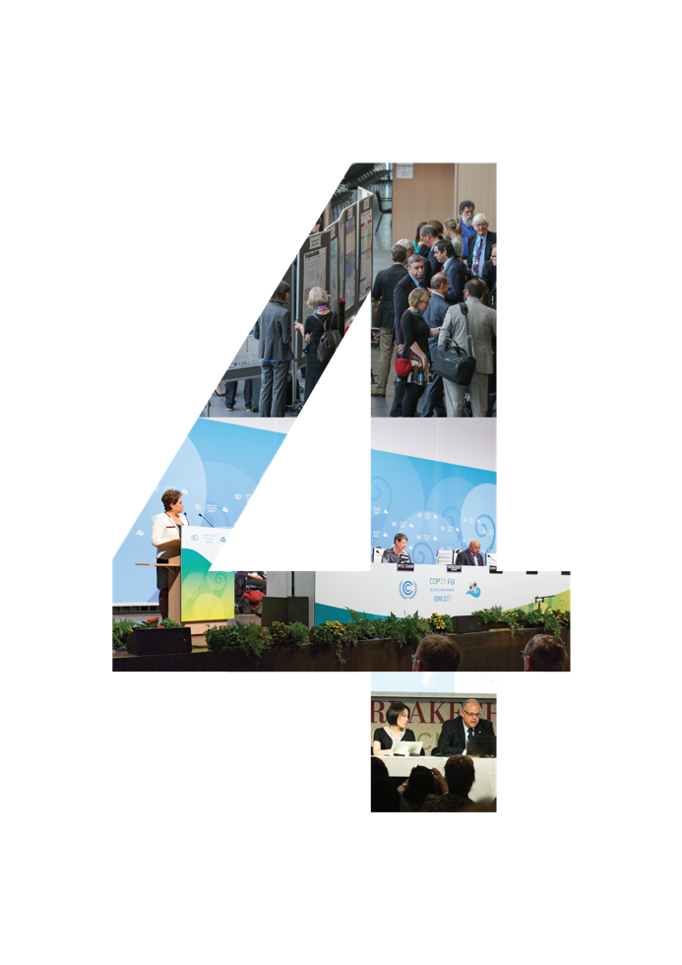
Scientific Objectives
We will support innovation in the generation and delivery of decision-relevant information and knowledge about the evolving Earth system.
Emphases:
Interactions with social systems: Social processes and emergent behaviour in the Earth System. Interactions and feedbacks between climatic and socioeconomic systems
Engaging with society: Actionable climate information, scientific assessments, educational approaches and public communication strategies

Slide 8
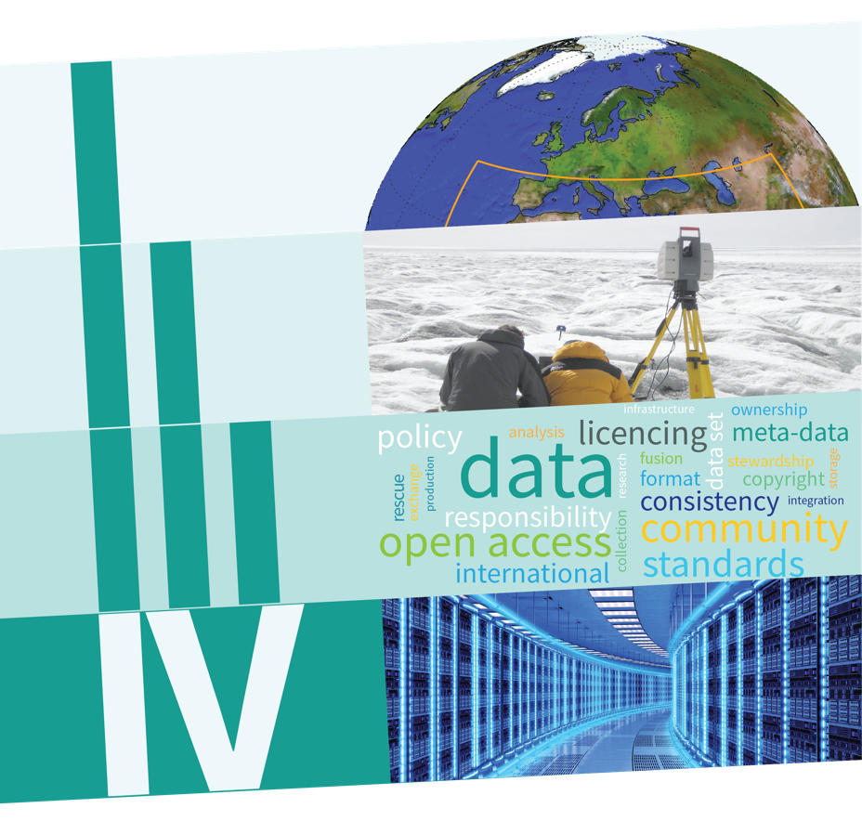
Critical Infrastructure
I. A hierarchy of simulation tools
II. Sustained observations and reference data sets
III. Need for open access
IV. High-end computing and data management

Slide 9
WCRP Implementation Plan: Background
  What is an Implementation Plan?
  It will put the WCRP Strategic Plan into action
  It will include: resources, structures, milestones, deliverables, measures of success, risk assessment
Development of the Implementation Plan must:
Be a transparent «bottom-up» approach involving the entire community
Include consultation with the scientific community, agencies, academies, sponsors and other stakeholders
Ensure a fit-for-purpose structure, an effective governance, required resources, budgets and finance management.
Notes:
Slightly reworded.

Slide 10
WCRP Implementation Plan: Timeline
Phase I: From now to April 2020
Refine science questions and conceptual framework
Refine key elements for operations, delivery and engagement
Identify science, funding, and infrastructure needs
Undertake consultation
Produce the first draft of the Implementation Plan by the time of the 41st Session of the JSC, April 2020
Phase II: April 2020 to April 2022
Undertake further consultations and evolution of the Implementation Plan
Develop structure and governance model
Clarify the future of Core activities and Project Offices
Initiation of new, joint activities
Expand and consolidate partnerships for mutual benefits
Adopt Implementation Plan and agree on Transition Approach by the 43rd Session of the JSC, April 2022
Notes:
Slightly reworded.

Slide 11
WCRP Implementation Plan: Progress
Implementation and Transition Meeting, 4-5 May 2019
Representatives of the WCRP community discussed how to implement the WCRP Strategic Plan, starting with the:
WCRP Strategic Plan
Feedback from the WCRP Review
Responses to an on-line survey
WCRP Joint Scientific Committee Session (JSC-40), 6-10 May 2019
Further discussion and refinement, with the main outcomes of:
Engagement, dialogue and discussion: community-building and a community effort
Development of draft Key Science Question areas and key elements
A “Conceptual Framework” for implementing the WCRP Strategic Plan

Slide 12


Key Science Question areas
Aggregation and scaling
Aerosols
How can we better understand climate sensitivity?
How to improve climate modelling and process understanding?
What is the impact of different forcings?
What fundamental
science is needed?
How can we communicate uncertainty better?
How can we make predictions more useful and relevant to society’s needs?
Disruptive technology
Parameterization
How can we improve climate predictions?
What opportunities do new technologies provide?
What will happen in the high latitudes?
Considering all scales
What will be the impact of Geoengineering?
Is response action needed?
What does society need to know?
Data-model fusion
What can we expect in regional climate hotspots?
What will happen to low-lying islands?
Prediction
Attribution
How will reservoirs change in the future?
Heat
How will climate extremes occur in the future?
What is the interaction between climate and development trends?
Urbanization
Carbon
Evolution
Water
Land-use
Change

Slide 13
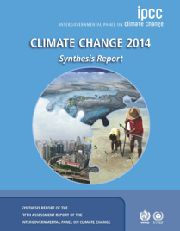
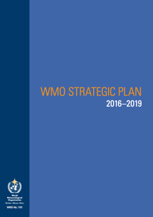


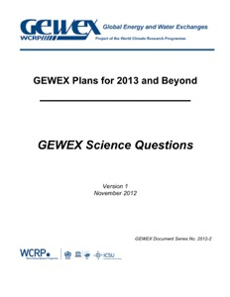


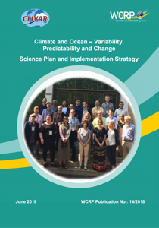
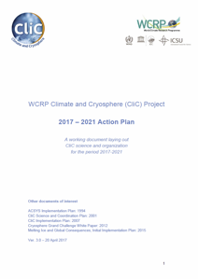

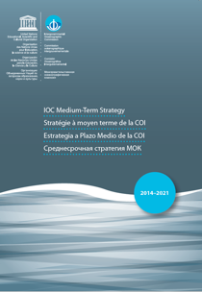
Refining Key Science Question areas
We will refine science question areas via consultation with:
The WCRP Community
Science Plans of the WCRP family
Partners (including by co-design)
Horizon scanning done by Partners
Gap and needs assessments

Slide 14
Implementation Plan Elements
  Jointly through dialogue and
  co-design
Research Projects
  Lifecycle (start and end) with a clear timeline and deliverables
  Joint and co-designed with Partners outside WCRP
  Deliver to Strategic Plan Objectives
  WCRP attributes: Integration; Scale; Relevance; Climate Change; Discovery and Innovation
Enduring capability - people:
Climate System Elements
Infrastructure and Integration
Conferences, Workshops, WCRP Forum
Projects and fora to engage and empower ECRs; and regional partners: part of the WCRP family
Regular Syntheses, Assessments, Gap Analyses
Rapid Assessments and Reports
Reference data sets (observed, modelled)
Educational services and activities
Coordination
Stakeholder engagement and outreach
Evaluations, Inter-comparisons, Benchmarking, Standards
Capacity building and communication

Slide 15
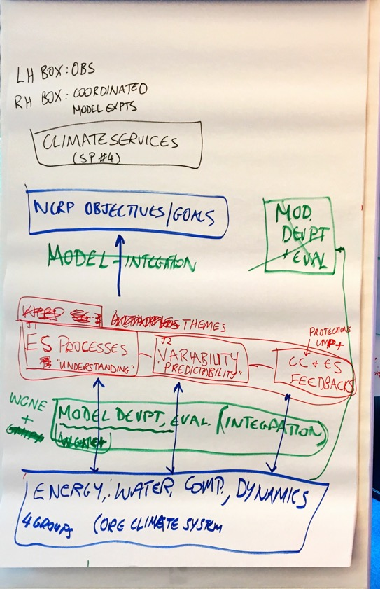
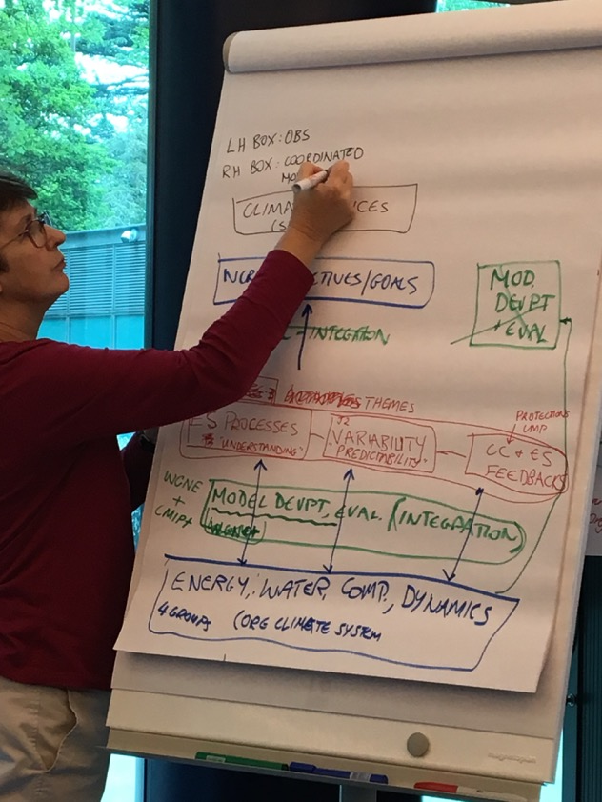
Conceptual Framework: from this to…

Slide 16
WCRP Mission: Societally-relevant knowledge and information
to inform mitigation, adaptation and risk management
3
Bridging climate
science and
society; managing climate risk
[Partnerships] Coordinated Model Experiments and Assessments | Production | Evaluation
[Partnerships] Links to sustained observing systems (e.g. GCOS)
Climate change
Projections and
ESM
feedbacks
Stakeholder engagement and dialogue
Partnerships, collaboration and dialogue
4
1
Understanding
Earth System Processes
Variability,
Predictability and Prediction
2
Science Questions: Relevance, Innovation, Discovery, Integration
Function: Integration across Earth System (Local to Regional to Global)
Earth System Model Development| Observing system innovation and evaluation| Model – Data fusion
Fora and services for Capacity development, Education, Community building
Function: Infrastructure
Simulation tools| Seamless data| Sustained obs.| High-end comp.; data storage & management| Platforms for open access, data sharing, collaboration
Climate
System
Elements
Function: Enduring capability and Link to science communities
Water, Energy, Composition, Dynamics, (Biosphere)
Ocean, Atmosphere, Cryosphere, Land
Global
and
Regional
Notes:
[Comments]
Need consultation with each and all WCRP groups, to ensure their engagement and possible places in the new structure
To identify groups that outlived their purpose to decide the sunset/transition and transformation into the new structure
To create any structural elements with timeline and sunset dates!, in agreement with sponsors/partners
[Core Principles]
Continuity of business during transition (CPs, WGs, GCs… for work, funding, etc.)
IP to be supported by: 1) WCRP Science Community, 2) funding agencies, 3) 3 co-sponsors, 4) national science agencies & academies
Effective governance and structure that enables/support the conceptual framework
Consistent with the WCRP SP
(communication aspects to be added – where they are going, where to fit, when the steps would happen…)
Key Science Questions – to identify a few condensed questions (~3 to 4?), not a shopping list
Timeline
Timeline and plan to be presented at the WMO Congress (June 2019)
2019: 2st draft of the structure required to implement the new SP, considering community views and sponsors’ suggestions/requirements
Dec 2019 (40th anniversary): discuss and reflect on IP
~mid 2020: revision of IP
Research Projects
Clear timeline and deliverables
Joint/co-designed as needed with Partners outside WCRP
Draw on capability from blue & green boxes
Deliver to SP objectives, aligned to one of 4 themes
Meet WCRP criteria of scale, science quality
Projects and for a to engage and empower ECRs as part of WCRP family
Conferences Workshops, WCRP Forum
Regular Synthesis, Assessments, Gap Analyses
Rapid Assessment and reports (can be one-off)
Reference data sets (observed, modelled)
Evaluations, inter-comparisons, benchmarking
coordination
Educational services, activities
Stakeholder engagement
Communications, knowledge, brokering and outreach

Slide 17
Implementation Plan: Draft Structure
1. Introduction
2. The WCRP Strategy: Vision, Mission and Objectives
3. Engagement
4. Framework
5. Partnerships
  Identifying key partners
  Co-designing science questions
  Identifying common infrastructure
  Clarifying their role in the Strategy
  Reaffirming current, and building new
6. Implementation
  Transition Plan
  Schedule: Gantt chart, milestones, deliverables
7. Measures of success
8. Risks and contingencies
Phase II
(by May 2022)
Phase I
(by May 2020)
Fully consultative development
Will include:
Support functions (including support offices)
External governance: sponsors, Joint Scientific Committee, Governing Board, Joint Planning Staff (Secretariat)
Internal structure and governance
Resources, budgets, finance management

Slide 18
Implementation Plan: Roadmap
Before the end of 2019:
Task Teams on Regional Activities, Modelling and Data
Interaction with Future Earth: Landscape discussion
Interaction with WWRP/GAW and other partners
Meeting with WCRP Sponsors
Early 2020:
WCRP High-level Science Questions and Flagship Workshop: February 2020
WCRP Elements and Structure Workshop: March/April 2020

Slide 19
Implementation Plan: Roadmap
May/June 2020:
JSC-41: Approval of WCRP Implementation Plan:
High-level science questions and flagship product
Elements of the new WCRP
Collaboration landscape and interfaces to partners
Governance
Financial plan
After JSC-41:
Request from Sponsors for approval of plan
Writing of WCRP Implementation Plan
Community and agency outreach, including fundraising

Slide 20
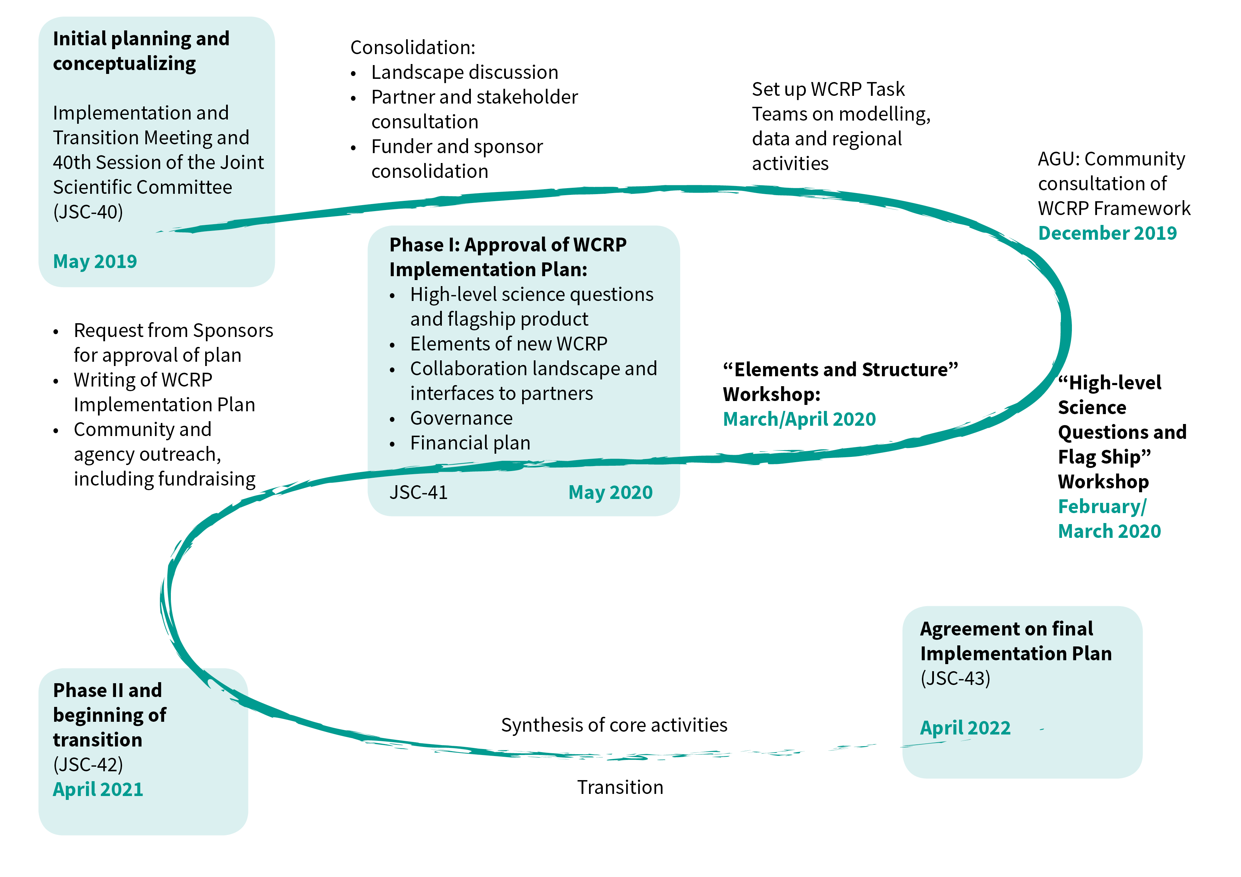
Implementation Plan:
Milestones

Slide 21
Thank You
World Climate Research Programme (WCRP)

