Slide 1
WORLD CLIMATE RESEARCH PROGRAMME
WCRP High-level Science Questions and Flagship Workshop
Detlef Stammer and Helen Cleugh (WCRP JSC Chair and Vice Chair)

Slide 2
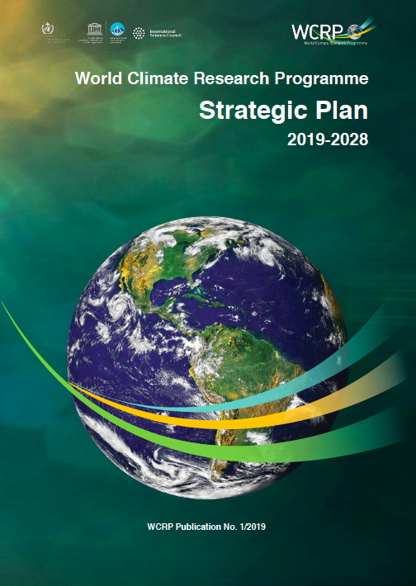
The future of WCRP
WCRP Strategic Plan
2019 - 2028

Slide 3
The new WCRP Strategy
The Vision (our aspiration)
A world that uses sound, relevant, and timely climate science to ensure a more resilient present and sustainable future for humankind.
The Mission (what we do, our purpose)
Coordinate and facilitate international climate research to develop, share, and apply the climate knowledge that contributes to societal well-being.

Slide 4
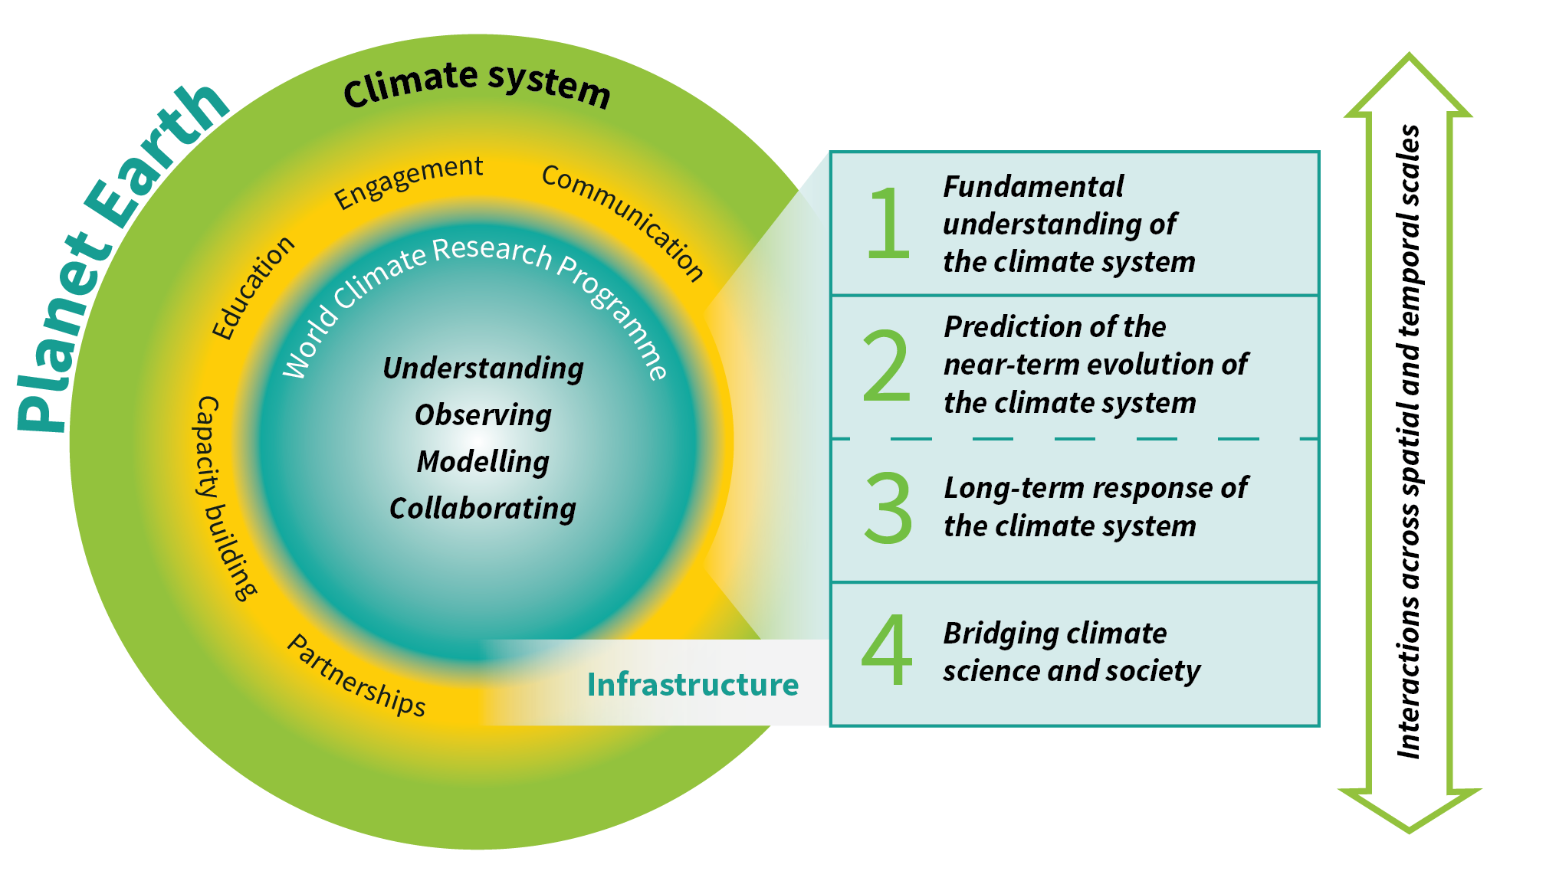
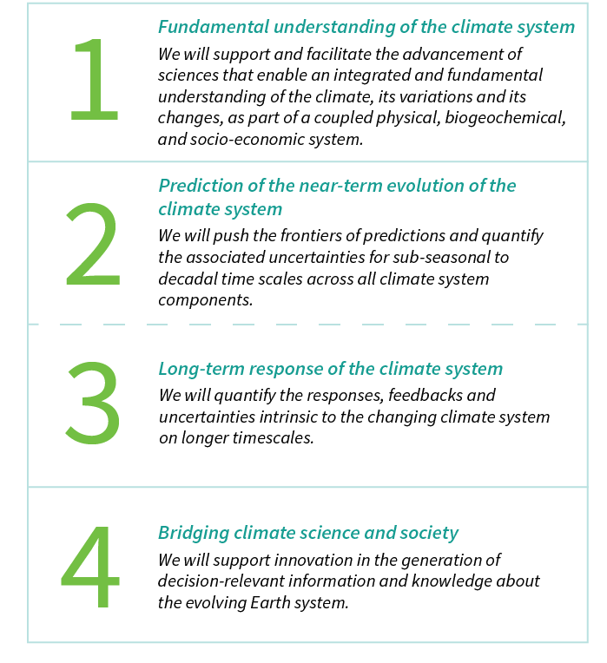
WCRP Strategic Plan
Scientific Objectives
A hierarchy of simulation tools
Sustained observations and reference data sets
Need for open access
High-end computing and data management
www.wcrp-climate.org/wcrp-sp
Notes:
This slide shows:
1. The circle describes the role of WCRP:
The scope of the WCRP – i.e. the climate system as part of the global Earth System. This highlights the importance of the inter-connectedness of the Earth System [outer circle]
That Understanding, Observing, Modelling and Collaborating are at the very core of the WCRP [inner circle]
The WCRP facilitates research across the international climate science and stakeholder community so collaboration, partnerships and engagement are critically important [middle circle]
The WCRP also plays a key role in Education and Capacity Building [middle circle]
2. The WCRP’s 4 Scientific Objectives [click to reveal detail]
Note the importance interactions across time and space scales
Users of climate knowledge, data and information require this seamlessly across all time scales – from the past, the present and into the future; so this seamlessness and integration are key for achieving the 4th scientific objective
3. These objectives and the WCRP’s role are underpinned by [click to make detail disappear]:
Simulation tools, especially weather, climate and Earth System models
Sustained observations that track the evolution of the climate system – long-term trends and surprises; as well as being critical for process understanding
WCRP are committed to information and data being available and discoverable by all
The nature of our science means that high performance computing and data management are also critically necessary
Note that the focus of this Conference and much of the remainder of this talk will be on how the WCRP science is being used to generate and facilitate the use of decision-relevant information and knowledge about the evolving Earth system

Slide 5
The Path towards Implementation
Prioritize WCRP science that will enable rapid progress towards providing societally-relevant climate information by identifying:
“Lighthouse Activities¹” that go beyond the capacity of an agency or nation and that will make critical near-term progress towards WCRP achieving its Vision, Mission and four Scientific Objectives
“Implementation Priorities” that will help the implementation by prioritizing near-term climate science needed to provide robust and actionable regional to local climate information e.g. to implement SDGs and inform climate adaptation and mitigation (including intervention) strategies
Identify elements that will facilitate and enable WCRP’s delivery of these scientific advances, and achieving its Mission
Community consultation and consolidation …
1: Major experiments, high-visibility projects, or infrastructure building blocks

Slide 6
Hamburg Workshop – Initial Goal
The specific goal was to discuss the two key aspects required to implement the WCRP Strategy, especially:
What are the Lighthouse Activities that are needed to make critical near-term progress towards meeting WCRP’s Vision, Mission and four Scientific Objectives?
What are the major Implementation Priorities that need to be undertaken by WCRP in the near-term to fundamentally advance climate science so that it is able to meet and be relevant to society’s urgent and emerging needs
WCRP High-level Science Questions and Flagship Workshop, Hamburg, 24-26 February 2020

Slide 7
Hamburg Workshop − Outcomes
As a result of discussions both during and after the workshop, this thinking was refined as follows ....
Firstly, the science and capacity building pursued as Lighthouse Activities will lead to scientific outcomes that are critical to support emergent societal needs for robust and actionable regional to local climate information.
Secondly, delivery of robust and consistent regional climate information to stakeholders is needed to inform, for example, the implementation of Sustainable Development Goals, disaster risk reduction, and climate adaptation, mitigation and intervention strategies.
So, what are the Lighthouse Activities and Implementation Priorities needed for WCRP to implement its Strategy and make progress towards its Mission and Scientific Objectives?

Slide 8
Implementing the WCRP Strategy
WCRP will implement its Strategy by prioritizing its science and by pursuing a series of Lighthouse Activities, along with other core research activities, to deliver and achieve its Mission over the next decade

Slide 9
Proposed Lighthouse Activities
Explaining and Predicting Earth System Change
My Climate Risk
Safe Landing Climates
WCRP Academy
Digital Earths
These draw on WCRP’s fundamental science, critical infrastructure and strategic partnerships

Slide 10
Implementation Priorities
Foster and deliver the scientific advances and future technologies required to:
Advance understanding of the multi-scale dynamics of Earth’s climate system
Quantify climate risks and opportunities

Slide 11
Implementation Priorities
Develop new institutional and scientific approaches required to:
Co-produce cross-disciplinary regional to local climate information for decision support and adaptation
Inform and evaluate mitigation strategies

Slide 12
Next Steps
Consultation and feedback
Engage and consult with Co-Sponsors, Partners, and Agencies during 2020 - 2021
Implementation Plan development during 2020 - 2021
Writing
Community and agency consultation and outreach
Hamburg Workshop Report – shared with attendees (late March, 2020)
In-principle approval by 2021
Consultation, feedback and refinement via virtual meetings throughout 2020
Elements Workshop; JSC-41; Model & Data Workshops
Shared with WCRP family and partners for consultation and refinement (April through May, 2020)
Notes:
Updated for COVID-19 – see after thank-you slide for original

Slide 13
Thank You
World Climate Research Programme (WCRP)

